Slide 1
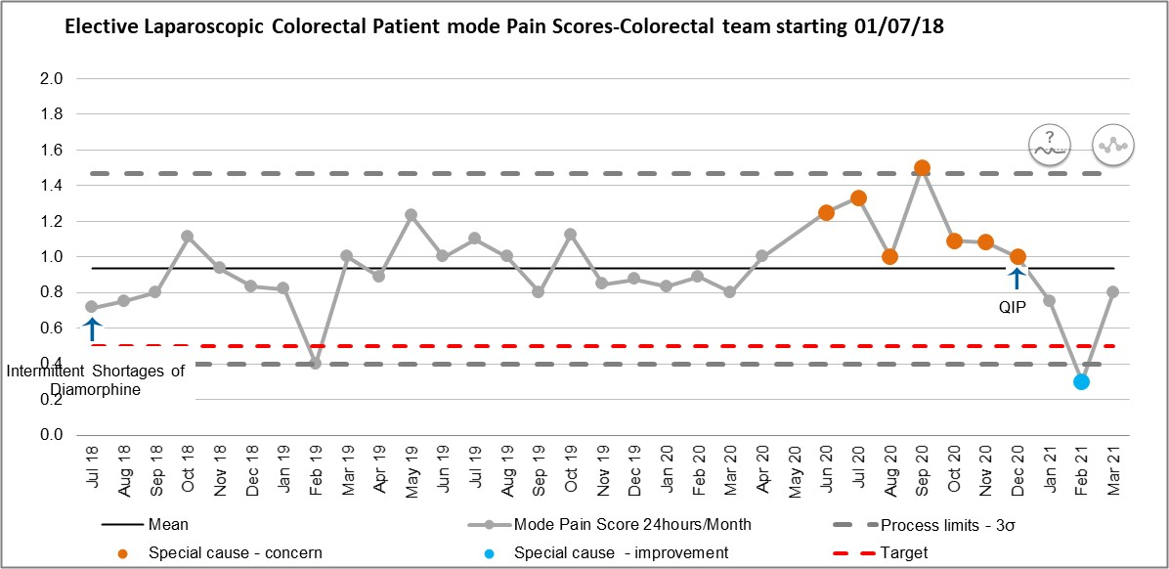
Individualised Pain Management for Patients Undergoing Elective Laparoscopic Colorectal Surgery
Dr Daniel Paul (Quality Improvement Fellow), Dr Rachel Brown (Consultant Anaesthetist) , Dr Mark Abou-Samra (Consultant Anaesthetist),
Dr Ed Keevil (Consultant Anaesthetist), Sarah Harrison (Colorectal Nurse Practitioner), Mr Paul Mackey (Consultant Colorectal Surgeon). Musgrove Park Hospital, Somerset, UK.
Intro
PQIP 2019 Report showed Elective Colorectal D1 Bauer Pain Scores and Anaesthesia Satisfaction with Pain were worse than National
Traced via site 10 year colorectal database (>1300 patients) to Laparoscopic Cases – triangulated via multiple Pain Metrics
Clear statistical process control chart signal (Chart 1) in worsening Day 1 Pain scores; since intermittent diamorphine shortages for intrathecal use (2018)
Worsened much further since March 2020 complete restriction of diamorphine at site
Majority of patients now receiving only Paracetamol, IV Opiates and Local Infiltration of Anaesthesia (LIA) with subsequent poor pain control
SMART Aim: To improve the monthly mean average “day one patient mode pain score”
for patients undergoing laparoscopic colorectal resections by 0.5 by 1st July 2021
Initial plans to use PQIP D1 Bauer Patient Reported Experience Measures (PREM) and DrEaMing metrics BUT As of March 2020: No Longer able to use continuous prospective PQIP data as collection stopped due to reallocation of research resources for SARS-CoV-2 research projects.
Local Quality Improvement Project Management Structure: “7 Steps to Quality Improvement”
Specific Quality Improvement Methodology’s added included: Evidence4QI (Literature Review), Multidisciplinary Collaboration, SMART Aims, Statistical Process Control Charts, Driver Diagrams, PDSA Testing
Outcome Measures:
“Day one patient mode pain score” – pre-existing prospective database used for previous research work¹
Post operative first 24hour opiate usage (Mg Equivalent to Oral Morphine)
Process Measures: Components of Analgesic regimes required: Paracetamol/Spinals/Regional/opiates/IV alternatives
Balancing Measures: Staff feedback, Incident/Note reviews, prospective Ileus Rates/Day 1 Mobilisation/Length of Stay/Bowels Open
Chart1: XmR Statistical Process Control Chart (MR Component not show)
Mean “Monthly Mode 24hour pain score” (0-3, none/mild/moderate/severe) in first 24hours post op for patients undergoing Elective Laparoscopic Colorectal Surgery
Results
Mean monthly “mode pain score” in first 24hours post op
Methods
Outcomes
Clear and rapid improvement in primary outcome. Astronomical data point (Chart1) suggesting statistical significance (February 2021)
XmR chart chosen as moving range accounts for variation in underlying monthly numbers of patients ( accounts for disruption of COVID)
Clear signal SPC chart signal seen in other surrogate markers including Mg equivalent Oral Morphine usage in first 24hours
Process
High protocol usage rates (96%)
Less intrathecal diamorphine usage than historically – from around 90% to around 50%, many more L-TAP blocks around 10% to 50%
Ongoing poor pre or intra op paracetamol usage (25% nil till recovery!)
Balancing
No seen side effects in 41 patients, no incidents, no change in run charts of other balancing measures (LOS possibly improving).
Fig1: Driver Diagram
Substantial literature review of contemporary practice – no clear best approach– even in relatable recent research²
Driver Diagrams used for divergent and convergent idea generation and planning
Clear need for Individualised Pain Management and shared decision making
patient factors,
Surgical options: LIA vs Laparoscopic TAP Blocks
Anaesthetic options: intrathecal Diamorphine, regional techniques, magnesium, clonidine, ketamine etc
Multidisciplinary Anaesthetic, Acute Pain, and Surgical collaboration to rationalise approaches
IVI Lidocaine and Intrathecal Morphine rejected on safety grounds
substantial infrastructure requirements including potential HDU bed requirement
in context of SARS-CoV2 Wave 2 beginning
Conclusion
Fig2:Individualised Pain Management Protocol
Rigorous use of Quality Improvement methods can lead to substantial multidisciplinary team buy in, problem understanding, and achieve significant improvements in patient outcomes.
Loss of PQIP Dataset due to SARS-CoV-2 research capacity resulted in need for surrogate measures, only able to use as a pre-project calibration point for acceptable patient experience. Unable as of yet to correlate to DrEaMing outcomes.
Continuous data metrics and operationalisation of existing data sources can lead to confidence in effects changes make for patients
Triangulation of metrics gives confidence when data may have underlying downsides (Non-linear None/mild/mod/severe pain scales converted to numerical)
Use of narrative qualitative data with quantitative data maximises understanding
When no one size approach works quality improvement methods allow safe and effective individualisation of patient pain management.
Ongoing SPC chart dashboard development to enable sustainability and earlier review of statistically significant signals in future but prevent overreactions to normal variation in data.
Aiming to realign with PQIP PREM and DrEaMing metrics (PQIP restarting at site soon…..)
Acknowledgements:
Thank you to all members of the Anaesthetic, Colorectal Surgical, Acute Pain, Local and National PQIP Teams with out whom this would not have been possible.
References
1) Tudor EC, Yang W, Brown R, Mackey PM. Rectus sheath catheters provide equivalent analgesia to epidurals following laparotomy for colorectal surgery. Ann R Coll Surg Engl. 2015;97(7):530-533. doi:10.1308/rcsann.2015.0018
2) Brown L, Gray M, Griffiths B, Jones M, Madhavan A, Naru K, Shaban F, Somnath S, Harji D; NoSTRA (Northern Surgical Trainees Reseach Association). A multicentre, prospective, observational cohort study of variation in practice in perioperative analgesia strategies in elective laparoscopic colorectal surgery (the LapCoGesic study). Ann R Coll Surg Engl. 2020 Jan;102(1):28-35. doi: 10.1308/rcsann.2019.0091. Epub 2019 Jun 24. PMID: 31232611; PMCID: PMC6937613.

